Slide 1

Mini Project
Mini Project
Group : 07 (Mini Project 1)
CSE 106
Discrete Mathematics Section : 06
Topic Name : Directed Graph
Group : 07 (Mini Project 1)
Course Code: CSE 106
Course Title: Discrete Mathematics Section : 06
Topic Name : Directed Graph

Slide 2
SUBMITTED TO
Dr. Mohammad Salah Uddin
Associate Professor, CSE Department
SUBMITTED BY
Abdullah Al Sahaf
ID: 2024-3-60-499
Abdullah Al Shah Nawaz
ID: 2024-3-60-502
Md. Arifur Rahman Razu
2024-3-60-503

Slide 3
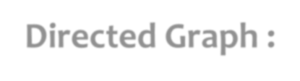


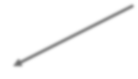








Directed Graph :
A directed graph is defined by a set of vertices and a set of directed edges.
V5
V1
E6
E5
E1
V6
E4
V2
V4
E2
V3
E3

Slide 4







Presenting Graph
Graph
Adjacency List
Adjacency Matrix
Adjacency List : A adjacency list is a way of representing a graph using a collection of lists or array.
Adjacency Matrix : An adjacency matrix is a way of representing a graph using a 2D array.

Slide 5
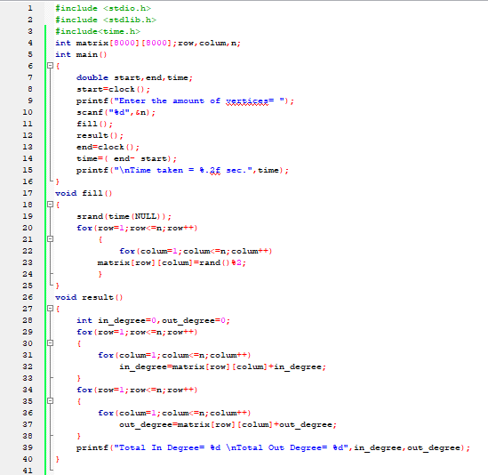

Slide 6
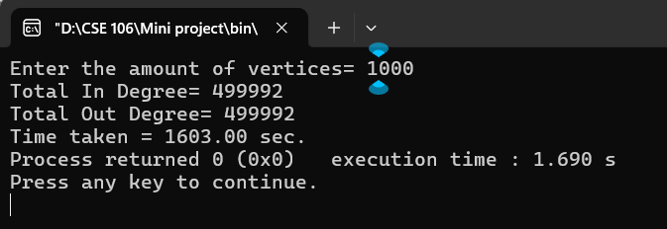
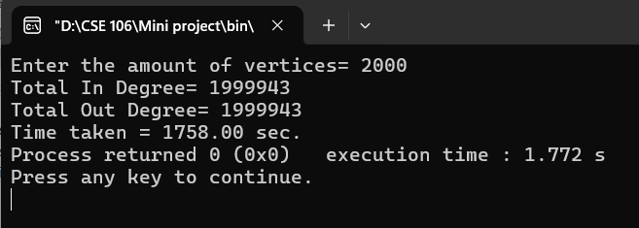
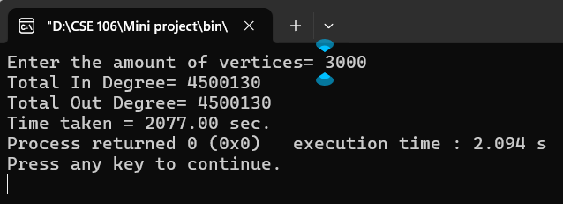
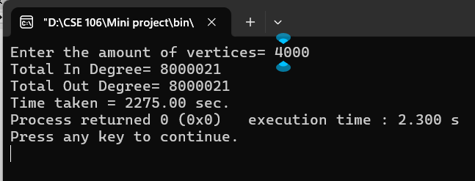
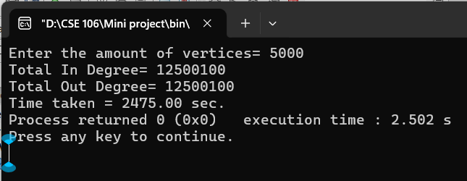
Outputs :

Slide 7
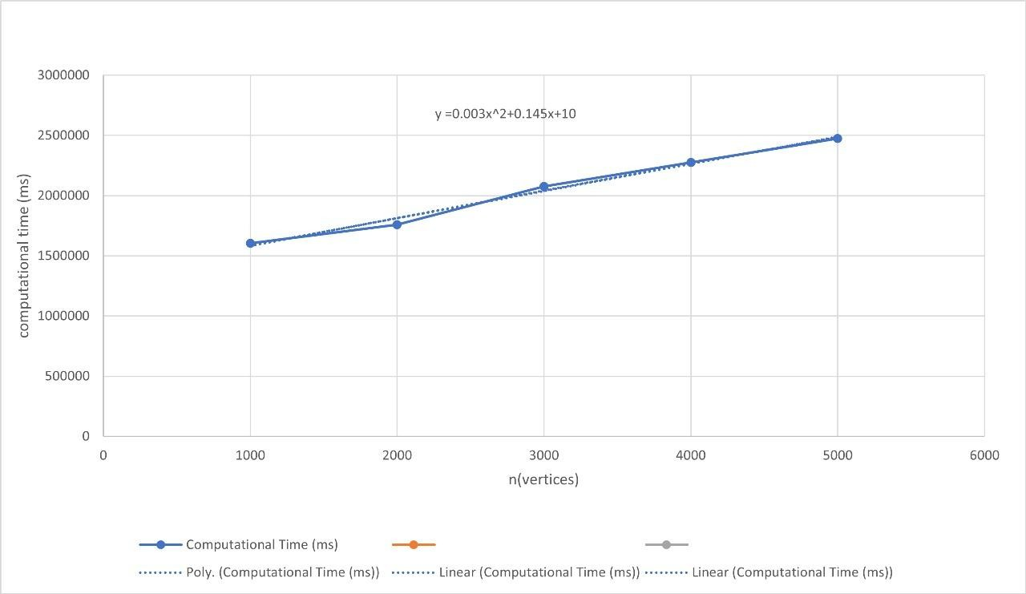

Slide 8
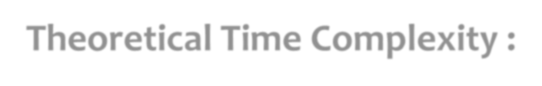
Theoretical Time Complexity :
Time complexity represents how the computational time of a program increases as the input size grows.
We use an n × n adjacency matrix to represent the graph.
To generate the graph, we fill an n × n matrix, which requires O(n^2) operations.
For each of the n vertices, we perform O(n^2) operations to calculate both in-degree and out-degree. Total operations = O(n) × O(n)
= O(n^2)
Total time complexity = O(n^2) + O(n^2)
= O(n^2)
Theoretical Time Complexity :
Time complexity represents how the computational time of a program increases as the input size grows.
We use an n × n adjacency matrix to represent the graph.
To generate the graph, we fill an n × n matrix, which requires O(n^2) operations.
For each of the n vertices, we perform O(n^2) operations to calculate both in-degree and out-degree. Total operations = O(n) × O(n)
= O(n^2)
Total time complexity = O(n^2) + O(n^2)
= O(n^2)

Slide 9
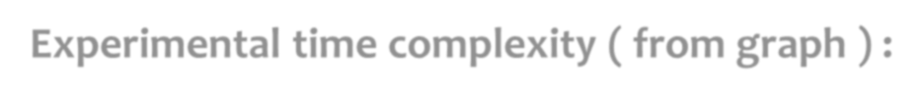





Experimental time complexity ( from graph ) :
The equation of the trendline was of the form :
Y = 0.003x^2 + 0.14x + 10
The highest degree term in the equation is x^2, which confirms that the time complexity grows quadratically with n. The trendline shows a quadratic relationship between the computational time and n.
The experimental results also suggest that the complexity of the program is O(n^2). Comparison : Theoretical vs Experimental :
From analyzing the code, we determined that the time complexity is O(n^2).
From the excel graph and the polynomial trendline, confirming that the experimental time complexity ia also O(n^2). Both the theoretical and experimental time complexity of the program are O(n^2).
Experimental time complexity ( from graph ) :
The equation of the trendline was of the form :
Y = 0.003x^2 + 0.14x + 10
The highest degree term in the equation is x^2, which confirms that the time complexity grows quadratically with n. The trendline shows a quadratic relationship between the computational time and n.
The experimental results also suggest that the complexity of the program is O(n^2). Comparison : Theoretical vs Experimental :
From analyzing the code, we determined that the time complexity is O(n^2).
From the excel graph and the polynomial trendline, confirming that the experimental time complexity ia also O(n^2). Both the theoretical and experimental time complexity of the program are O(n^2).

